Slide 1
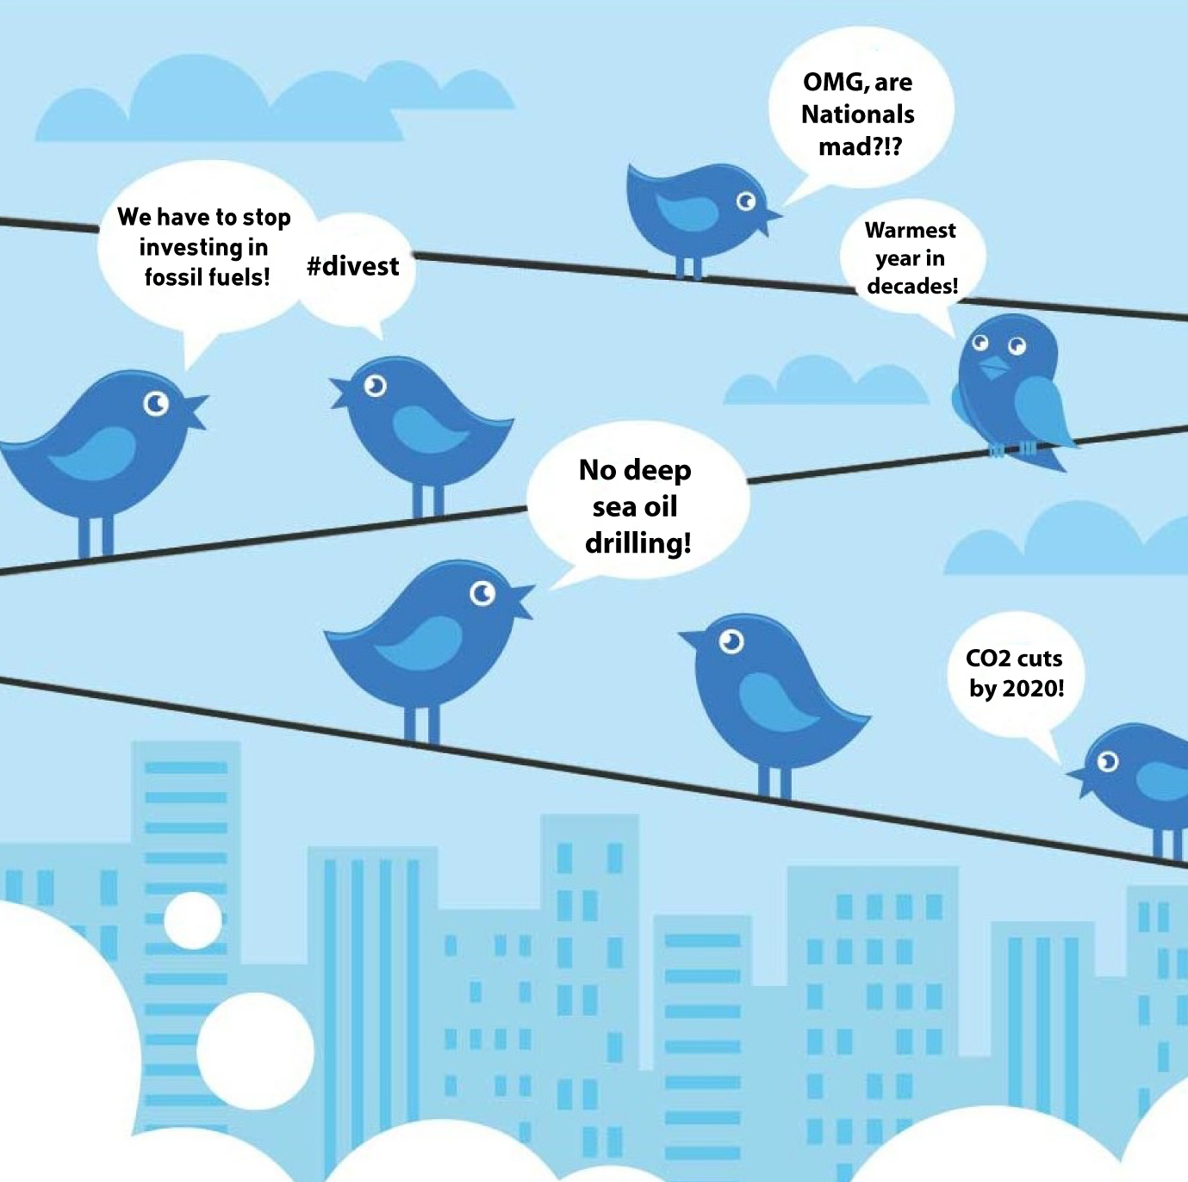
Climate Change Discourse on Twitter
Isabel Arvelo
Notes:
Hi, my name is Isa and I will be walking through a text analysis of tweets about climate change in 2022.
Climate change poses significant threats to our environment, health, and economies and addressing it is our societal responsibility to ensure justice and sustainability for vulnerable communities and future generations. With its vast and diverse user base, Twitter provides insights into a wide range of perspectives on climate change and influential figures often use Twitter to communicate their view.

Slide 2

Motivation
What are the main topics, themes, and narratives that dominate climate change discussions on Twitter? What does the discourse tend to focus on?
What individuals, organizations, and other entities are most influential in shaping the climate change narrative?
Notes:
The answers to these questions can help us gauge public understanding and sentiment regarding climate change, help in spotting misinformation or biased perspectives. And recognizing the key players and influencers in the discourse can aid in collaboration, partnerships, and mobilization efforts for climate action.

Slide 3
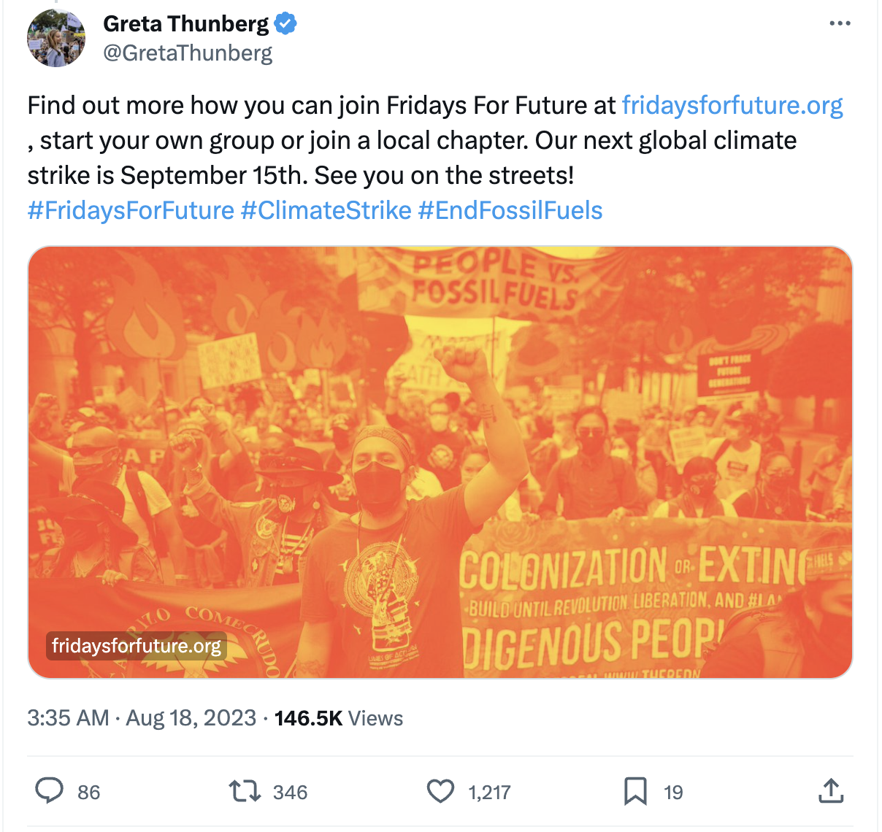
Dataset Overview: Climate Change Tweets on Twitter
Source: Tweets scraped by Kaggle user Diego Farchione
Duration: Captured from January 2022 to July 2022.
Content: Highlights top tweets with the keyword 'Climate Change’ between January 2022 to July 2022.
Key Features (for each tweet):
User & Tweet Details:
User Screen Name, Username, Text, Date
Engagement Metrics :
Comments, Likes, and Retweets
Additional Context:
Emojis, Image Link
Notes:
My dataset is from Kaggle and includes 7 months of twitter data scraped by user Diego Farchione between January and July 2022. Each row in the dataset represents a tweet posted in the period and the columns represent information about the tweer including user & tweet details, engagement metrics and additional context

Slide 4
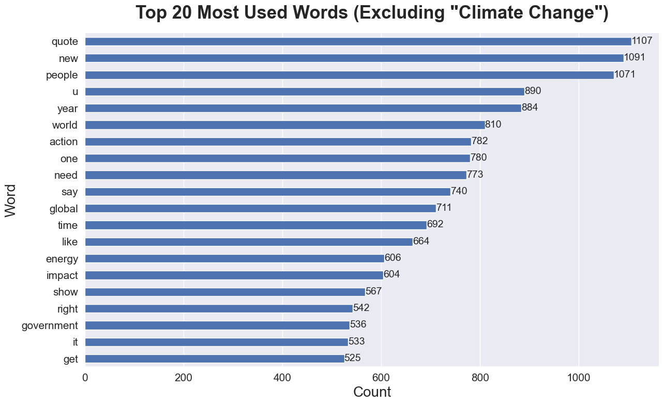
Word Frequency
Referencing & Responsibility:
"quote," "people," and ”u"
Urgency & Action:
"action," "need," and ”time"
Global topics & Solutions:
"energy," "impact," and "global"
Notes:
The y axis represents the top 20 most commonly used words excluding the words climate change and other common stopwords on twitter , with the most common term at the top
the x axis represents the count or the number of times each word appears in the corpus of tweets. The numbers themselves aren’t as important as the relative frequency of words.
Referencing & Responsibility: High mentions of "quote," "people," and ”u" show a trend of referencing others and strong emphasis on the involvement or opinions of different people in the discourse
Urgency & Action: Terms like "action," "need," and ”time" highlight the immediacy and urgency in the climate change discourse.
Topics & Solutions: Words such as "energy," "impact," and "global" point to discussions on renewable solutions and global effects.

Slide 5
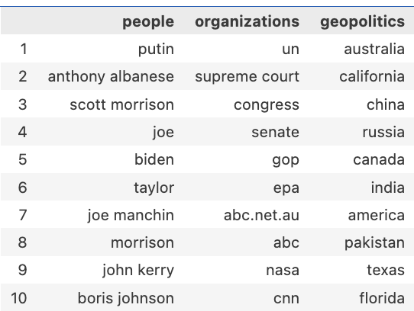
Named Entity Recognition
Top Mentioned Entities in Tweets
Prominent Figures & Politics
Climate change conversation is intertwined with political decisions and leadership
Global Institutions & Media
Global policies, legal discussion, media outlets
Global Spread
Shared responsibility and concern across continents
Table 1: A summary of the most frequently mentioned people, organizations, and geopolitical entities in the analyzed tweets.
Notes:
Named Entity Recognition (NER) is a process in which a computer program identifies and categorizes specific words or phrases from a text into predefined groups. Think of it as a tool that scans the tweets and highlights all the proper nouns, categorizing them into who's a person, which ones are organization, and what geopolitical entiies are mentioned.
The table shows the top 10 people, organization and geopolitical entities that appear in the corpus ordered with the greatest number of mentions for each column at the top of the table
People:
The mention of political figures like "Putin," "Anthony Albanese," indicates that the climate change conversation is closely intertwined with political decisions and leadership stances. These are global leaders whose actions and decisions have a significant impact on global climate policies and there appears to be a strong U.S. and Australian political angle
Organizations:
The "UN" (United Nations) being the top organization suggests discussions around global policies and agreements related to climate change.
Judicial entities like the "Supreme Court" and legislative bodies like "Congress" and "Senate" hint at legal and legislative discussions related to climate change.
The presence of media outlets and organizations such as "abc.net.au," "ABC," and "CNN" showcases the media's role in reporting, influencing, or driving the climate change narrative.
Geopolitics:
The wide range of places from "Australia" to "Russia" and "California" to "India" highlights the global concern of climate change. It's not confined to one region but is a shared responsibility and concern across continents.
In further analyses we could analyze the sentiment of tweets that mention the most popular entities

Slide 6
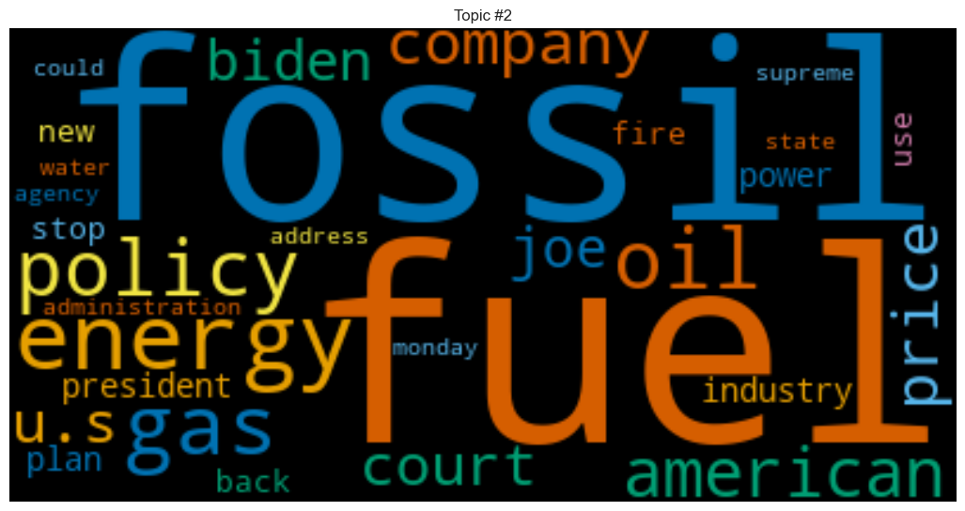
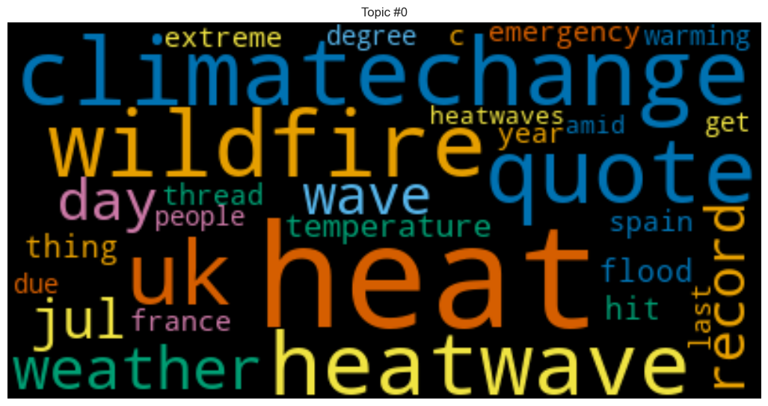
Topic Modeling
Topic modeling is a technique that automatically identifies and groups main themes or topics within large volumes of text
Energy Policies and Economic Implications
Climate-Induced Extreme Weather Events
Considering the risks and consequences of traditional fossil fuels as energy sources
Economic discussions related to the costs and implications of energy transitions
Direct effects of climate change, particularly heatwaves and wildfires
Challenges faced during summer or other critical times
Notes:
Topic modeling is a technique used to automatically identify and group related themes or topics within large volumes of text by looking at patterns and relationships between words. Think of it as a way to quickly understand the main ideas being discussed in a collection of documents without having to read every single tweet
Here I have two word cloud of words that appear in two topics I identified in the corpus. A word cloud visually represents text data by displaying the most frequently occurring words in larger sizes and bolder colors.

Slide 7

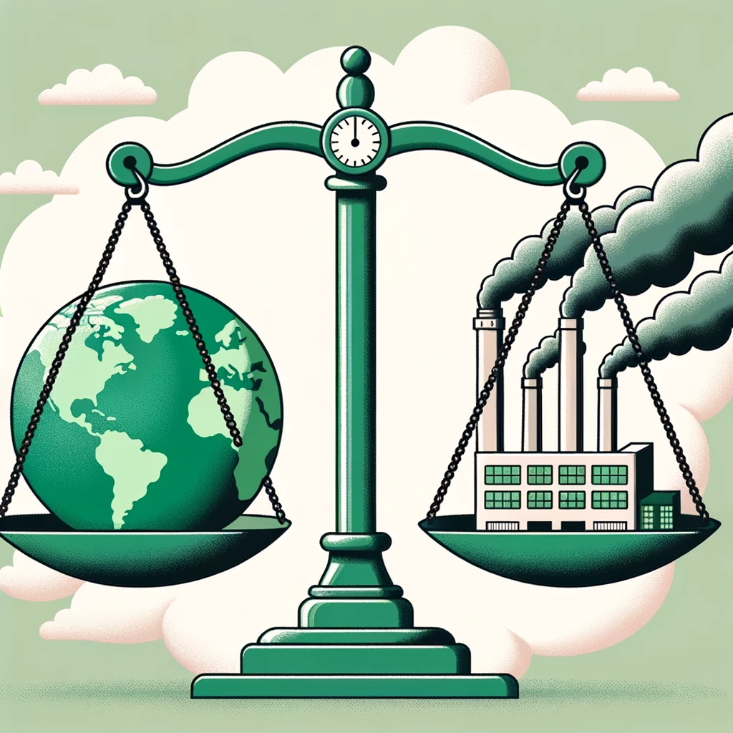
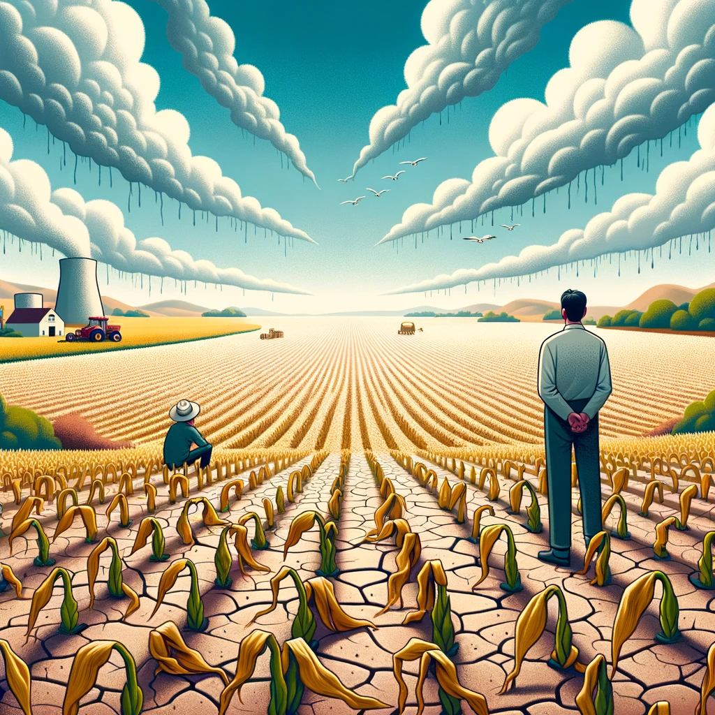
Takeaways
Word Frequency Analysis
Sense of urgency & need for immediate action
Solution-oriented discourse
Emotionally-charged debates
Named Entity Recognition
Politicized issue, especially in US
Media outlets shape narrative
Global issue with local impacts
Topic Modeling
Energy policies and economic implications
Extreme Weather Events
Notes:
Pitch:
- Twitter's climate discourse reveals an urgent, global conversation influenced by a mix of politicians, government bodies and media sources across the globe
- It's not just about recognizing the problem, but actively discussing solutions, impacts, and policies.
- From the challenges posed by energy transition to resilience in face of extreme weather events, these conversations are multifaceted
- Our initial insights point to rich discussions, but there's so much more to uncover.
- Diving deeper will allow us to grasp these narratives fully and steer the conversation towards tangible solutions.

